Slide 1

Perspective Projection
CS 418: Interactive Computer Graphics
UNIVERSITY OF ILLINOIS AT URBANA-CHAMPAIGN
Eric Shaffer

Slide 2
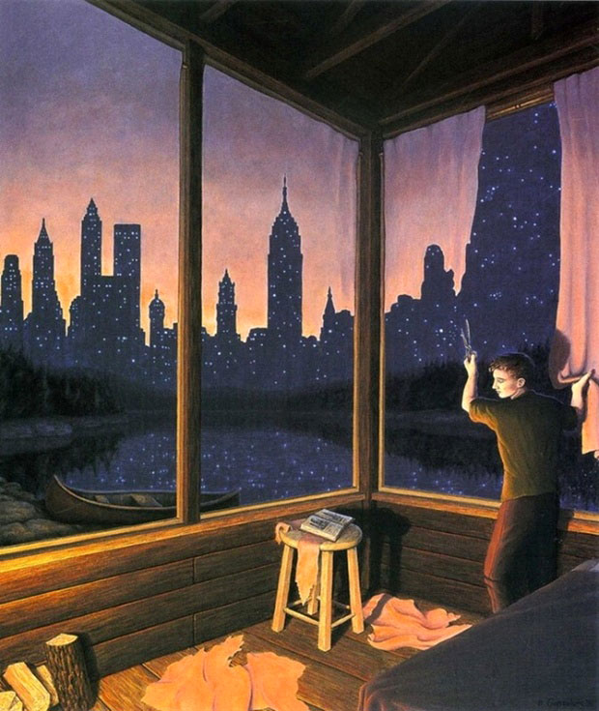
Perspective
Brain depends on shape constancy
Real world objects do not resize
Change in size due to depth
Closer objects larger
Farther objects smaller

Slide 3
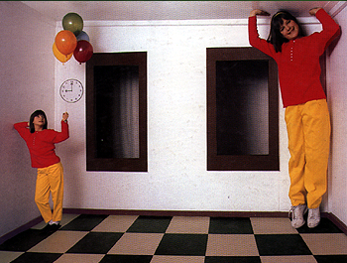
Ames Distorting Room

Slide 4
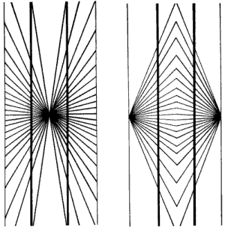
Hering Illusion

Slide 7
Perspective Projection
Objects further from viewer are projected smaller than the same sized objects closer to the viewer (diminution)
Looks realistic
Equal distances along a line are not projected into equal distances (nonuniform foreshortening)
Angles preserved only in planes parallel to the projection plane

Slide 8
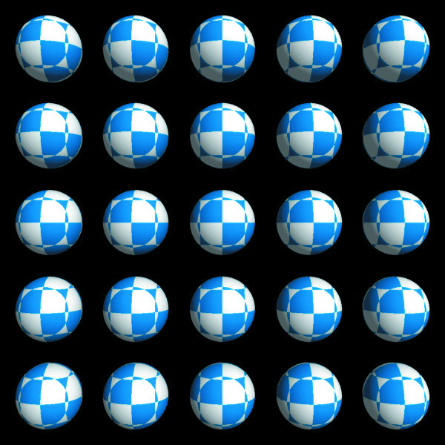

Perspective Distortion
Orthographic
Perspective
Should the spheres look like this? Why don’t our eyes see like this?
Notes:
Somce question

Slide 9
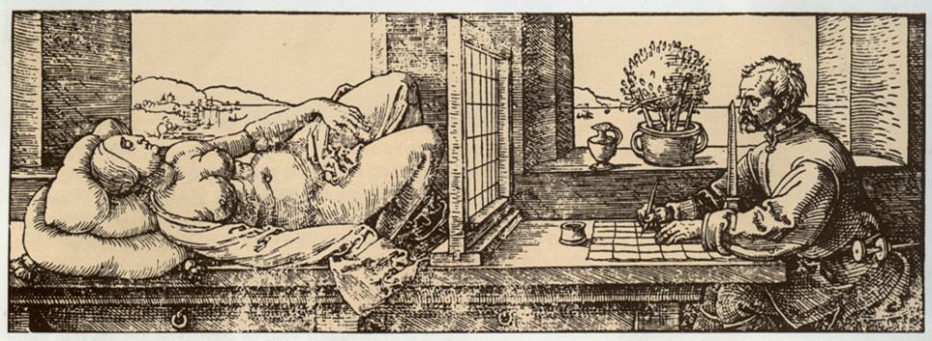
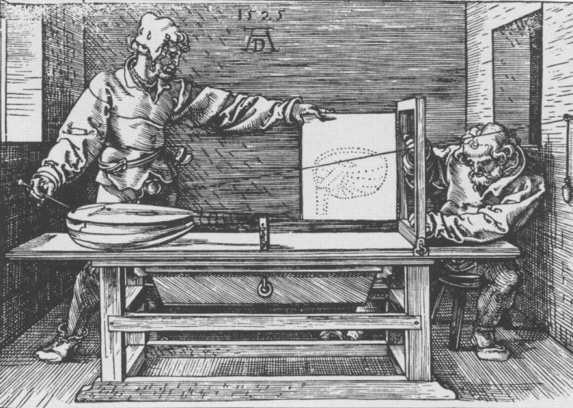
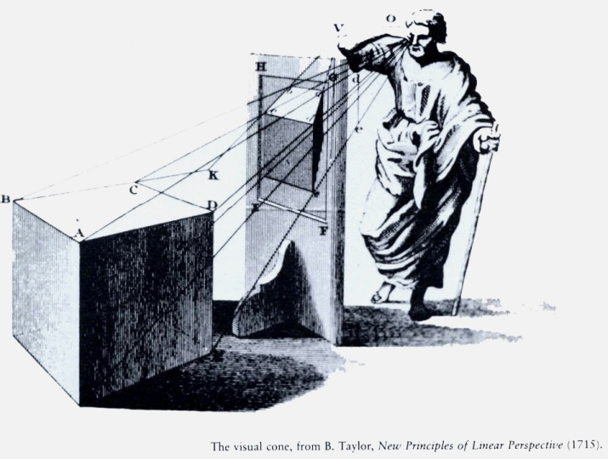
Simple Perspective Projection
Albrecht Durer woodcut c. 1525, swiped from Marc Levoy’s CS48N notes c. 2007
Brain depends on shape constancy
Real world objects do not resize
Change in size due to depth
Closer objects larger
Farther objects smaller
How large, how small?
More Durer, swiped from Fredo Durand’s Art of Depiction
?

Slide 10
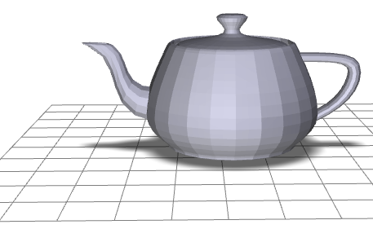
Simple Perspective
screen
y
y_{view}
y_{clip}
-z
z_{view}
d
Eye is at origin (0,0,0)
Screen is distance d from the eye.
Looking down negative z-axis.
The two triangles are similar (two angles are obviously congruent)
This means corresponding sides are in the same proportions

Slide 11
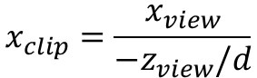
Simple Perspective
screen
x
x_{view}
x_{clip}
-z
z_{view}
d
Same process derives the projection for the x coordinate.
What is z_{clip}?
$$x_{clip}=\frac{x_{view}}{{−z}_{view}/d}$$

Slide 12
Simple Perspective
screen
x
x_{view}
x_{clip}
-z
z_{view}
d
This transformation is not invertible
It does preserve lines (except when?)
It is not an affine transformation (it does not preserve ratios of distances

Slide 13
Projections Using Homogeneous Coordinates
We can extend our use of homogenous coordinates to handle projections
Let the fourth homogeneous coordinate be any non-zero value w
To find the point it corresponds to:
multiply all four coordinates by 1/w
When homogeneous coordinate is zero
Denotes a “point” at infinity
Represents a vector instead of a point
Not affected by translation
A point in 3D corresponds to what in the 4D homogenous space?

Slide 14
Simple Perspective
screen
y
y_{view}
y_{clip}
-z
z_{view}
d
By allowing w to change we represent more kinds of transformations

Slide 15
Distance
screen
y
y_{view}
y_{clip}
y'_{clip}
-z
z_{view}
d’
d
y_{clip} = d y_{view}/(-z_{view})
y'_{clip} = d’ y_{view}/(-z_{view}) = (d’/d) y_{clip}
Changing parameter d just changes scale of projection
Using d
Using d’

Slide 16
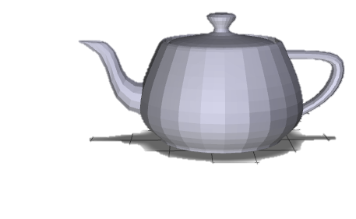
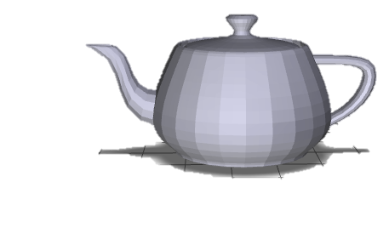
Perspective Distortion and Distance
screen
screen
y
y_{view}
y'_{clip}
y_{clip}
-z
z_{view}
d’
d
To change degree of perspective distortion, need to change distance from eye to scene,
…by moving scene closer or farther to eye,
… along z axis in viewing coordinates

Slide 17
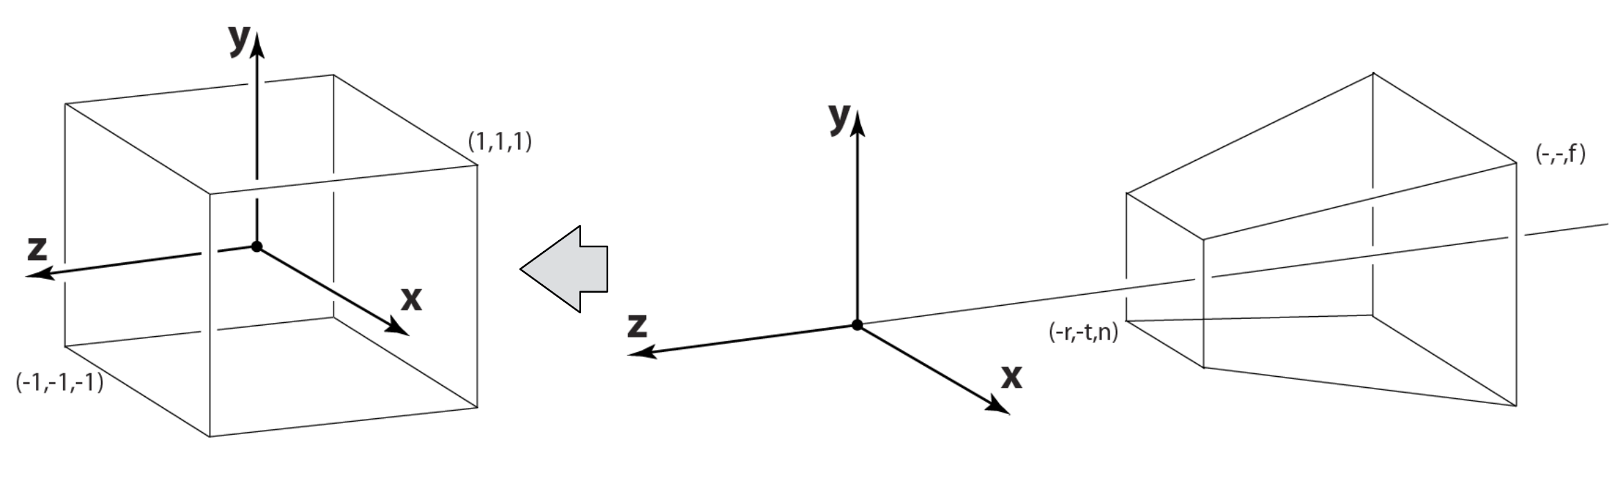
Perspective Projection in WebGL
Just like with parallel viewing we will
Define a viewing volume
Construct a normalization transformation
We turn a perspective projection into orthogonal projection
This allows us to use the built-in orthogonal projection in WebGL

Slide 18
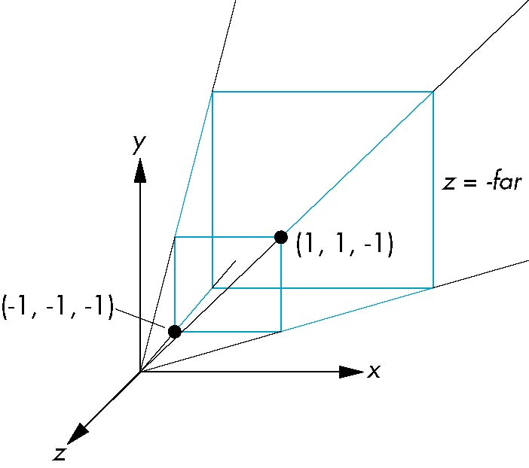
Perspective Normalization
Consider a simple perspective with
the COP at the origin,
the near clipping plane at z = -1, and
a 90 degree field of view determined by the planes x = ±z, y = ±z

Slide 19
Perspective Matrices
Simple projection matrix in homogeneous coordinates
Note that this matrix is independent of the far clipping plane
M =

Slide 20
Generalization
after perspective division, the point (x, y, z, 1) goes to
N =
x’ = -x/z
y’ = -y/z
z’ = -(α+β/z)

Slide 21
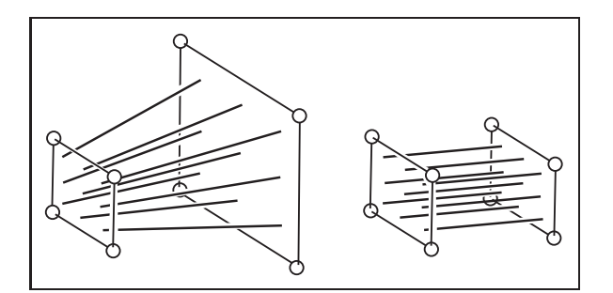
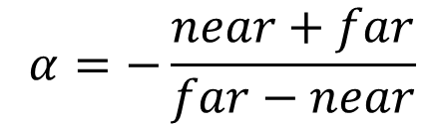
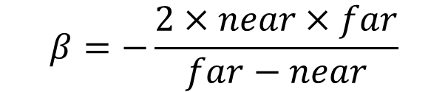
Picking α and β
If we pick
$$α=−\frac{near+far}{far−near}$$
$$β=−\frac{2×near×far}{far−near}$$
the near plane is mapped to z = -1
the far plane is mapped to z = 1
the sides are mapped to x = ± 1, y = ± 1
The new view volume is the default clipping volume

Slide 22
Projection and Hidden-Surface Removal
For two points p₁ and p₂, if z₁ > z₂ in the original clipping volume then for the transformed points z₁’ > z₂’
We can use z’ for hidden surface removal using depth comparison
The formula z’ = -(α+β/z) implies that the distances are distorted by the normalization
This can cause numerical problems especially if the near distance is small

Slide 23
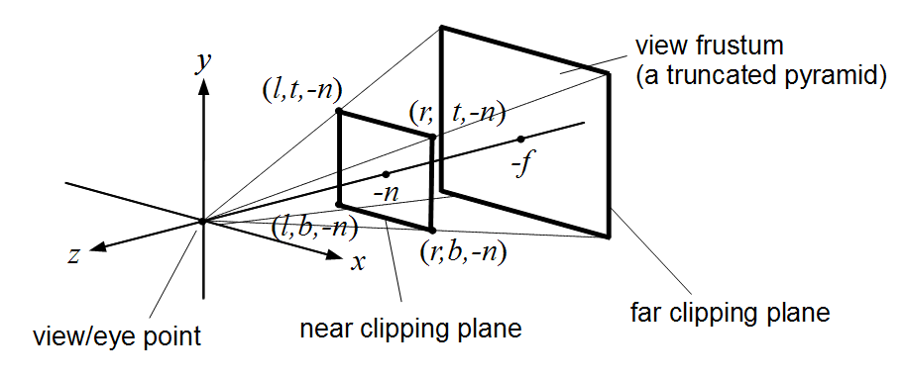
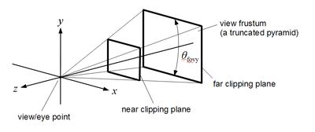
WebGL Perspective
mat4.frustum allows for an asymmetric viewing frustum using left, right, bottom, top, near, far
mat4.perspective generates a symmetric frustum using fovy, aspect, near, far fovy → vertical viewing angle in radians
aspect → aspect ratio of the viewport
near → distance from center of projection to near clip plane
far → distance from center of projection to far clip plane it computes a frustum with right=top x aspect top = near x tan(fovy/2) left = -right and bottom = -top

Slide 24
Perspective Matrices from glMatrix
frustum
perspective

Slide 25
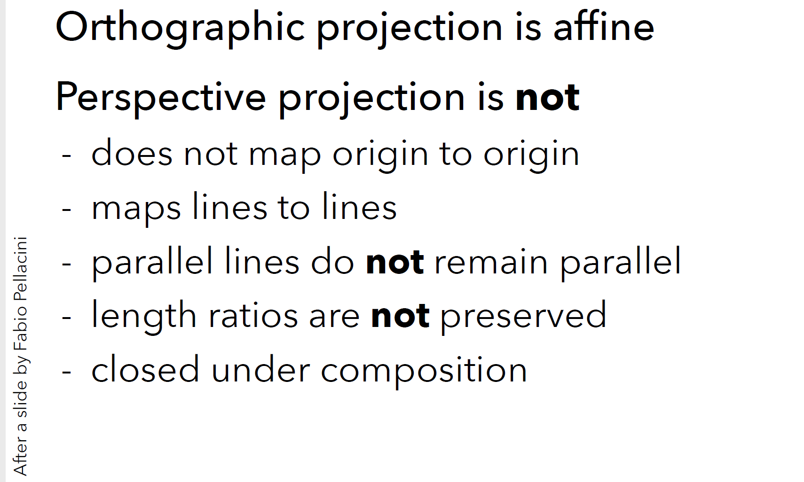
Projection Matrices

Slide 26
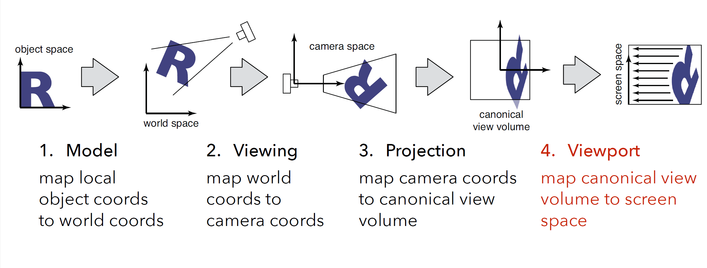
Chain of Transformations
Entire chain of transformation can be encoded as a single 4x4 matrix

Slide 27
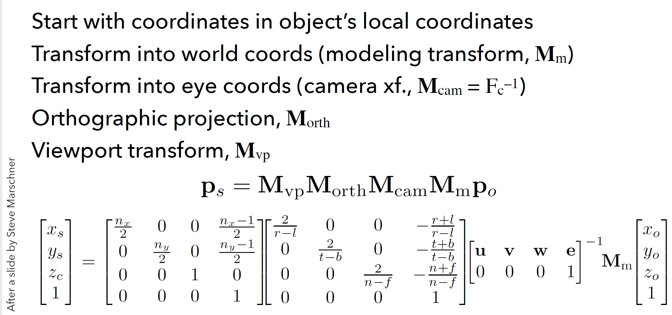
Orthographic Transformation Chain
Note: The projection matrix shown below does not flip the z-axis and the viewport starts screenspace at (-1/2, -1/2)

Slide 28
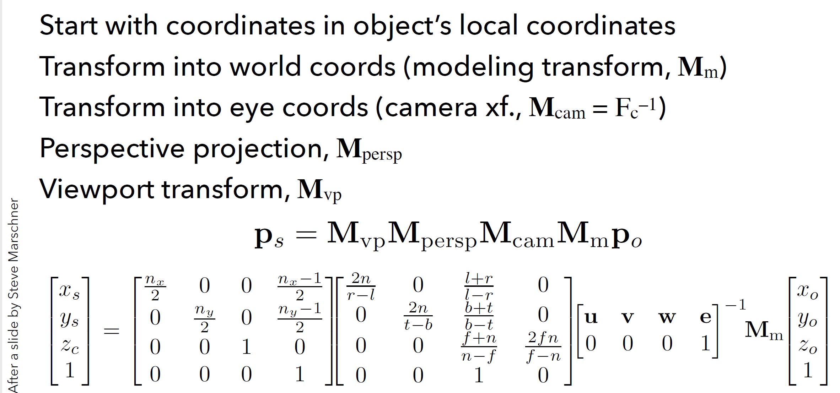
Perspective Transformation Chain
Note: The projection matrix shown below does not flip the z-axis and the viewport starts screenspace at (-1/2, -1/2)

